Slide 1


Data-Driven Growth Strategy: 2026 Sales & Inventory Analysis
Bright Motors Sales Analysis
Strategic Recommendations for Bright Motors Dealership Network
Turning historical data into a roadmap for future profitability.“
By Kometsi Khotlele

Slide 2
Executive Summary
The Goal: Optimize, Expand, and Outperform
Objective: Analyze historical sales to identify:-
- high-margin inventory
-top selling states
-Profitability
Lastly to chart a strategy to improve performance across all areas of the business, in particular the financial performance.
Methodology: Processed 79MB of transaction data with over 155k rows of data via Google Big Query.
Scope: Focus on revenue drivers, depreciation curves, and regional demand.

Slide 3
Vehicle condition
Excellent vehicles are mainly in the top 3 destinations being Colorado, Georgia and Pennyslavia.
Generally the condition of the vehicles remains good to excellent.
A minor portion of these vehicle are in poor state, condition

Slide 4
Mile age distribution
The mile age is high across all the states in comparison to the MMR value. The vehicles are selling minimally at breakeven of the MMR value.

Slide 5
Long range view
Revenue as generated is declining overtime with gross profit mark holding below the zero level, indicating a loss of revenue overtime.
The sales graph exposes the lack of coherent and consistent strategy for driving sales

Slide 6
The Profitability Gap (MMR vs. Selling Price)
Profitability factor
Despite the good sales produced across all categories. The profit remains negative across, the region and biggest losers are New Jersey, Florida and Texas in the top 3 losers. However small profit margins are recorded North Carolina, Washington, California etc. The overall profit remains negative for Bright Motors.

Slide 7
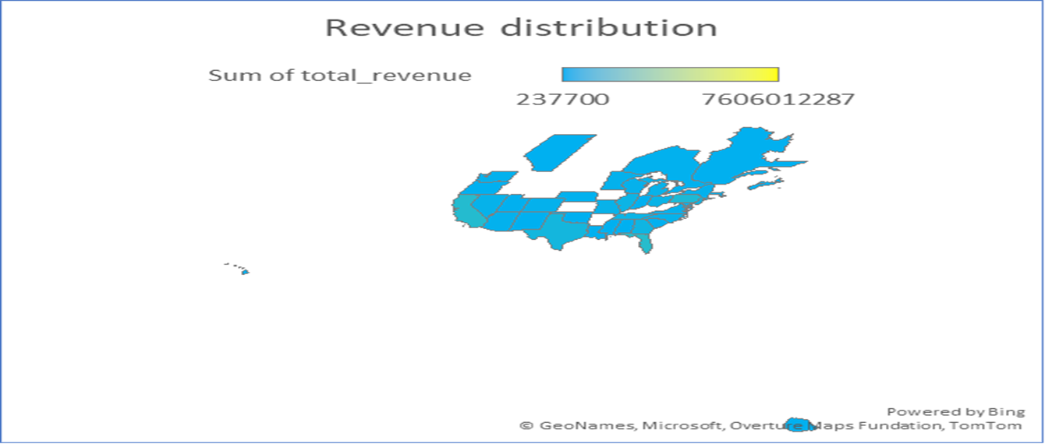
Hot Markets/ Regional Markets
Florida, California, Pennyslavia and Texas are the top selling areas indicating a high demand for vehicle in these areas

Slide 8
Sales drivers
Gasoline on an automatic transmission is an outlier pushing sales multiple folds ahead of manual transmission. Gasoline is popular among all transmission type claiming 93% of the sales share and diesel at 3%.

Slide 9
Discussions and Opportunities
The overall profit margins across all regions and product lines remain negative. The company is loosing revenue despite great sales turnover registered with minimal exceptions in some of the states, where the profit is positive.
There are serious growth and expansion opportunities as confirmed by huge sales volume in outlying states, like Pennyslavia and California.
In terms of revenue loss, the company must look into the cost of inventory acquisition so they can increase their profit margin. This requires an investigation into the cost of operation to check the inherent profit drainer activities, since ALL sold inventory showed sales above the MMR value.

Slide 10
Recommendations
Inventory Shift: Focus 60% of procurement on the top 3 identified "Profit Champions."
Pricing Engine: Implement an automated pricing alert when Selling Price deviates more than 5% from MMR.
Regional Allocation: Shift slow-moving inventory from low-volume states to high-heat regions.
Inventory Acquisition: Investigate the cost of inventory acquisition and concurrent introduction of reduction in operating costs for value creation in the bottom line.
Review product placing strategy by investing on online show room to shadow and boost non-performing regions.

